Slide 1
Credit Card Default Analysis
Tirunahari Lokendar

Slide 2
Abstract
Credit cards are big source of income when deftly managed. But errors in risk assessment can leads to stains on the balance sheet. The climbing delinquencies will result in significant amount of money loss from the lending institutions, such as those commercial banks. Therefore, it is very crucial for banks to have a risk prediction model and be able to classify the most relative characteristics that are indicative of people who have higher probability to default on credit card loans. A robust model is not only a useful tool for the lending institutions to make decision on credit card applications, but it can also help the clients to be aware of the behaviors that may damage their credit scores.
This model will help financial institutions, commercial banks and other loan institutes to predict a defaulter earlier.

Slide 3
Problem statement
Financial threats are displaying a trend about the credit risk of commercial banks as the incredible improvement in the financial industry has arisen. In this way, one of the biggest threats faces by commercial banks is the risk prediction of credit clients.
The goal is to predict the probability of credit default based on credit card owner's payment history,credit limit,age etc

Slide 4
Data set Information
The data set for training and testing contains the information of customers default payment. There are 30,000 different instances and 25 attributes total; each instance represents one customer, and attributes consist demographic information about the customers and their past payment history from April to September.

Slide 5
Attribute information
ID : unique identification number assigned to each customer LIMIT BAL : amount of given credit access line SEX : gender (1 = male; 2 = female) EDUCATION : highest degree obtained (1 = graduate school; 2 = university; 3 =high school; 4 = others; 5 = unknown; 6 6 = unknown)
a MARRIAGE AGE PAY 0 PAY 2 PAY 3 | : marital status (1 = married; 2 = single; 3 = others) : age in year : monthly payment record in September : monthly payment record in August : monthly payment record in July
PAY 4 PAY 5 PAY 6 BILL AMT1 BILL AMT2 BILL AMT3 BILL AMT4 BILL AMT5 BILL AMT6 PAY AMT1 PAY AMT2 PAY AMT3 PAY AMT4 PAY AMT5 PAY AMT6 | : monthly payment record in June : monthly payment record in May : monthly payment record in April : total amount owed in September : total amount owed in August : total amount owed in July : total amount owed in June : total amount owed in May : total amount owed in April : amount of previous payment in September : amount of previous payment in August : amount of previous payment in July : amount of previous payment in June : amount of previous payment in May : amount of previous payment in April

Slide 6
Approach
Exploratory data analysis
○ Diagnose data for cleaning.
○ Use data visualization to understand data and find the correlations between
variables. The questions regarding which factors would be strong indicators of
credit card default payment will get answered.
Data preparation and transformation
○ Prepare data to build a model
Data modelling
○ Predictive data analysis (logistic regression, random forests,xgboost,adaboost,neural networks etc)
○ Tune each model
Model evaluation and model presentation
○ Determine metrics of model evaluation
○ Compare different models

Slide 7
Model | Precision | Recall | F1-score | Roc-Auc
Logistic Regression | 0.38 | 0.65 | 0.48 | 0.71
Logistic Regression – (SMOTE) | 0.37 | 0.65 | 0.47 | 0.72
Logistic Regression - (ADASYN) | 0.35 | 0.70 | 0.46 | 0.67
Tuned Logistic Regression – (Random os) | 0.50 | 0.52 | 0.51 | 0.70
Tuned Logistic Regression – (SMOTE | 0.50 | 0.52 | 0.51 | 0.70
Tuned Logistic Regression – (ADASYN) | 0.50 | 0.52 | 0.51 | 0.65
Random Forest – (Random os) | 0.58 | 0.43 | 0.50 | 0.75
Random Forest – (SMOTE) | 0.49 | 0.49 | 0.49 | 0.74
Random Forest – (ADASYN) | 0.49 | 0.49 | 0.49 | 0.73
Tuned Random Forest –(SMOTE) | 0.50 | 0.52 | 0.51 | 0.76
Tuned Random Forest – (Random os) | 0.55 | 0.51 | 0.53 | 0.77
Tuned Random Forest –(ADASYN) | 0.48 | 0.52 | 0.50 | 0.7
Xgboost – (SMOTE) | 0.60 | 0.41 | 0.49 | 0.72
Xgboost - (Random os) | 0.47 | 0.62 | 0.54 | 0.80
Xgboost – (ADASYN) | 0.45 | 0.55 | 0.49 | 0.85
Tuned Xgboost – (Random os) | 0.47 | 0.62 | 0.53 | 0.83

Slide 8
Model | Precision | Recall | F1-Score | Roc-AUC
Tuned Xgboost -(ADASYN) | 0.46 | 0.51 | 0.49 | 0.87
Tuned Xgboost – (SMOTE) | 0.41 | 0.57 | 0.48 | 0.82
AdaBoost – (SMOTE) | 0.46 | 0.60 | 0.52 | 0.78
AdaBoost – (Random os) | 0.40 | 0.56 | 0.47 | 0.81
Tuned AdaBoost – (Random os) | 0.47 | 0.61 | 0.53 | 0.78
Tuned AdaBoost – (ADASYN) | 0.42 | 0.56 | 0.48 | 0.82
Tuned AdaBoost - (SMOTE) | 0.44 | 0.56 | 0.49 | 0.83
Neural Networks | 0.40 | 0.69 | 0.50 | 0.76

Slide 9
Though main objective is to find out the defaulter which basically means we need high recall for our model it is desirable to have a high precision since the bank wouldn’t want to lose customers who were denied a loan based on the model’s prediction that they would be defaulter.
Keeping all the above things in mind random forest is suggested.

Slide 10
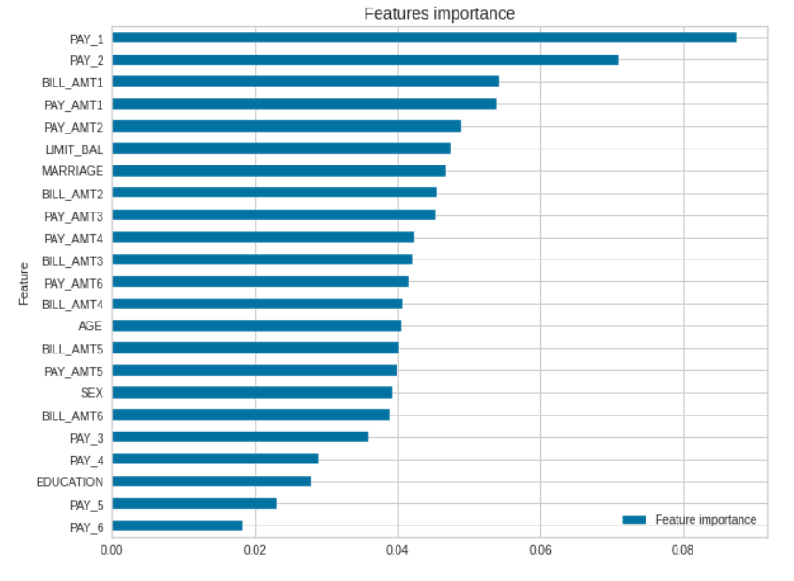
Best model Random Forest feature importance plot,top 3 features
PAY_1: most recent month’s payment
status.
PAY_2: the month prior to current month’s payment status.
BILL_AMT1: most recent month’s bill
amount.

Slide 11
Conclusions
Random Forest has the best precision and recall balance.
Higher recall can be achieved if low precision is acceptable.
This model serves as an aid to human decision.

